Slide 1

Edison Bluetooth
hello@hybus.net

Slide 2
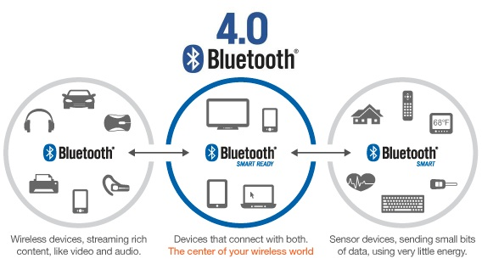
BLE
BLE(Bluetooth Low Energy) : Bluetooth4.0
Bluetooth SMART
2.4GHz ISM 40Channel(3Channel(advertise), 37Channel(data), 1Mbps(data speed)
Peripheral Device(Scan Device)와 Central Device(Sensor Device)로 구분
source : http://marketclarity.com.au

Slide 3
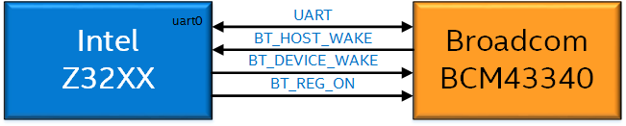
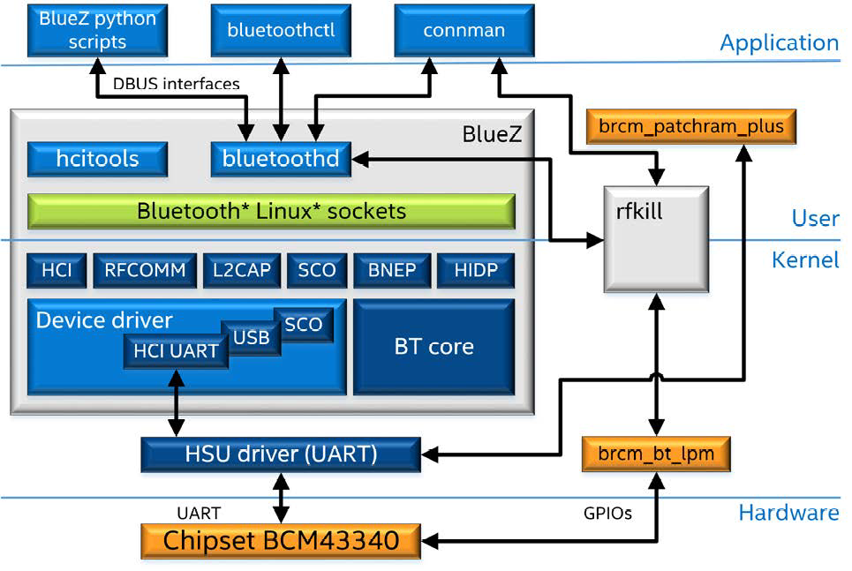
Edison Board BLE
The host processor on the Intel® Edison development board is connected to a Broadcom* BCM43340 combo chip via UART (uart0 mapped to /dev/MFD0) as transport layer and uses additional GPIOs to handle power (on, reset, etc.), OOB (out-of-band) signaling for UART to support low power mode.
source : http://download.intel.com/support/edison/sb/edisonbluetooth_331704004.pdf

Slide 4
Application interface - BlueZ
The application layer can use the Bluetooth service provided by the BlueZ stack using the DBUS API interface registered by each profile/component. The <bluez_package>/doc folder contains a text file that describes these DBUS API methods and properties.
source : http://cafe.naver.com/thingdue

Slide 5
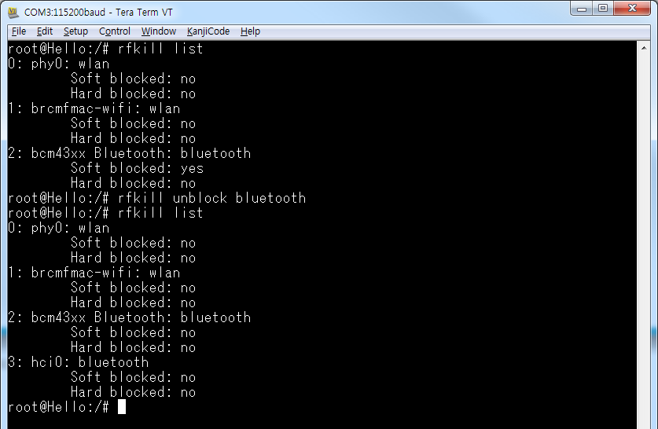
Edison Board Getting Started with Bluetooth
rfkill : Linux Kernel의 서브시스템으로 전파송수신 장치들에 대해 활성화/비활성화 할 수 있도록 해주는 인터페이스 제공
(Wi-Fi, Bluetooth, 3G, LTE 등), /dev/rfkill
To enable or disable Bluetooth, using the following commands respectively:
root@Hello:~# rfkill unblock bluetooth
root@Hello:~# rfkill block bluetooth
root@Hello:~# rfkill list
terminal
source : http://cafe.naver.com/thingdue

Slide 6
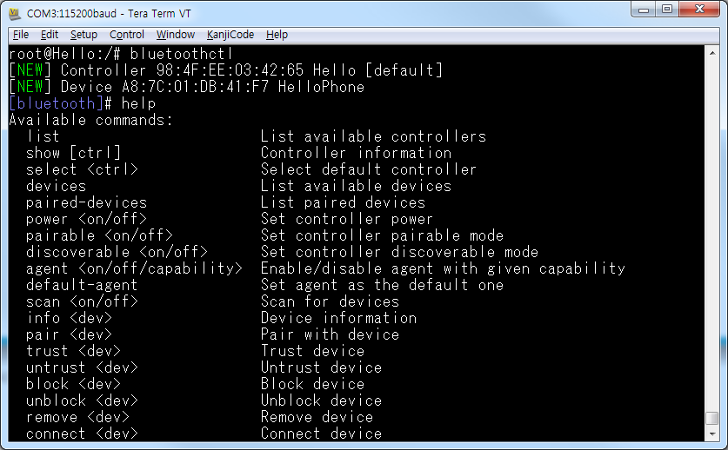
The bluetoothctl utility
Bluetoothctl : Bluetooth 기본동작에 필요한 Utility
- agent 등록
- Start or stop discovery
- Adapter의 pairable or discovery 속성 구성
- Pair and connect a device
root@Hello:~# bluetoothctl
[bluetooth]# help
terminal
source : http://cafe.naver.com/thingdue

Slide 7
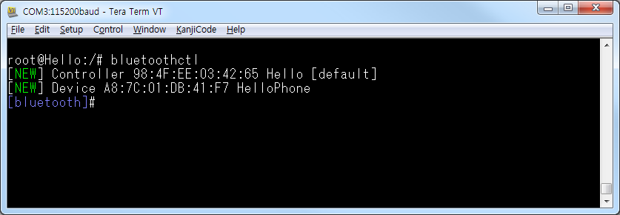
Scanning and Connecting Devices
To connect your Intel® Edison device to a Bluetooth network, do the following
1) Bluetooh 활성화
root@Hello:~# rfill unblock bluetooth
terminal
2) Bluetoothctl 실행
root@Hello:~# bluetoothctl
terminal
source : http://cafe.naver.com/thingdue

Slide 8
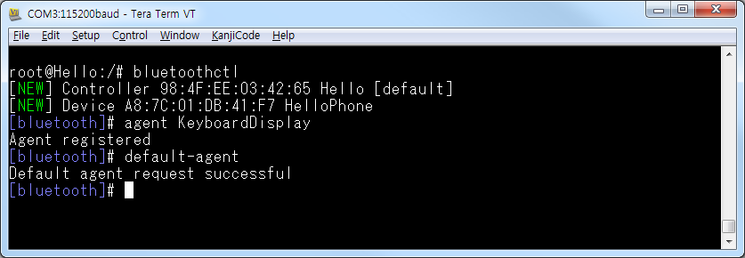
Scanning and Connecting Devices
3) Agent 등록 및 기본값 설정
Option : KeyboardDisplay, DisplayOnly, DisplayYesNo, KeyboardOnly, and NoInputNoOutput
[bluetooth]# agent KeyboardDisplay
[bluetooth]# default-agent
terminal
source : http://cafe.naver.com/thingdue

Slide 9
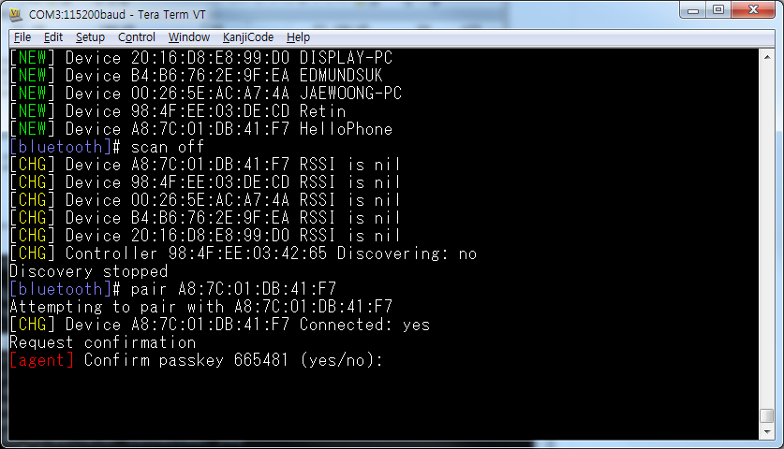
Scanning and Connecting Devices
4) BT 장치 검색
[bluetooth]# scan on
terminal
5) Pair the device
[bluetooth]# pair [addr name]
terminal
source : http://cafe.naver.com/thingdue

Slide 10
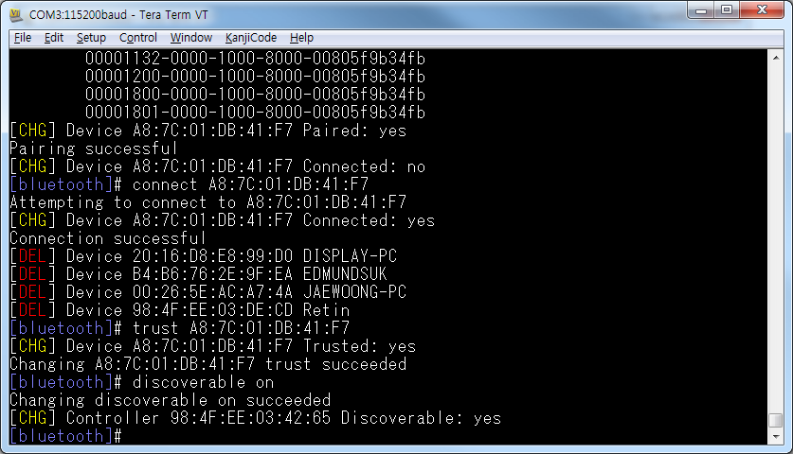
Scanning and Connecting Devices
6) Device Connection & trust
[bluetooth]# connect [addr name]
[bluetooth]# trust [addr name]
[bluetooth]# discoverable on
terminal
source : http://cafe.naver.com/thingdue

Slide 11
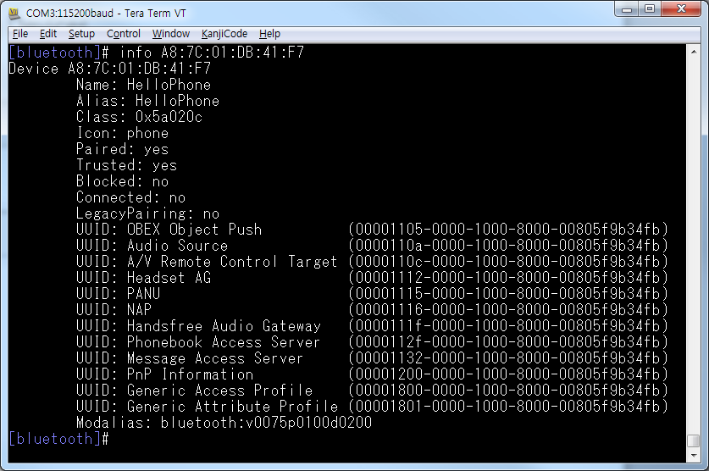
Scanning and Connecting Devices
7) Device info
[bluetooth]# info [addr name]
terminal
source : http://cafe.naver.com/thingdue

Slide 12
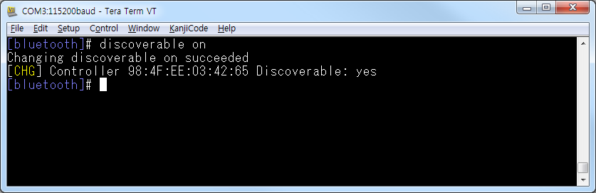
Connecting from a peer device
To connect your Edison device from a peer device, do the following
root@Hello:~# rfill unblock bluetooth
root@Hello:~# bluetoothctl
[bluetooth]# agent KeyboardDisplay
[bluetooth]# default-agent
terminal
[bluetooth]# discoverable on
source : http://cafe.naver.com/thingdue

Slide 13
SPP
SPP (serial port profile)
which is based on ETSI 07.10 and RFCOMM protocol, defines how two Bluetooth*-enabled devices create a virtual/emulated serial port connection and communicate with each other.
Bluetooth SPP Test
SPP (serial port profile)
which is based on ETSI 07.10 and RFCOMM protocol, defines how two Bluetooth*-enabled devices create a virtual/emulated serial port connection and communicate with each other.
SPP-loopback.py : SPP를 통해 다른 장치에서 데이터를 수신 받아 확인하기 위해 Python기반으로 작성된 파일
source : http://downloadmirror.intel.com/24909/eng/SPP-loopback.py
source : http://cafe.naver.com/thingdue

Slide 14
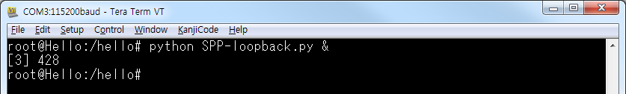
Bluetooth SPP Test
1) SPP-loopback 실행
root@Hello:~# python SPP-loopback.py &
terminal
2) Bluetooth 활성화/pair/connect/trust/discoverable
root@Hello:~# rfkill unblock bluetooth
root@Hello:~# bluetoothctl
[bluetooth]# pair [addr name]
[bluetooth]# connect [addr name]
[bluetooth]# trust [addr name]
[bluetooth]# discoverable on
terminal
source : http://cafe.naver.com/thingdue

Slide 15
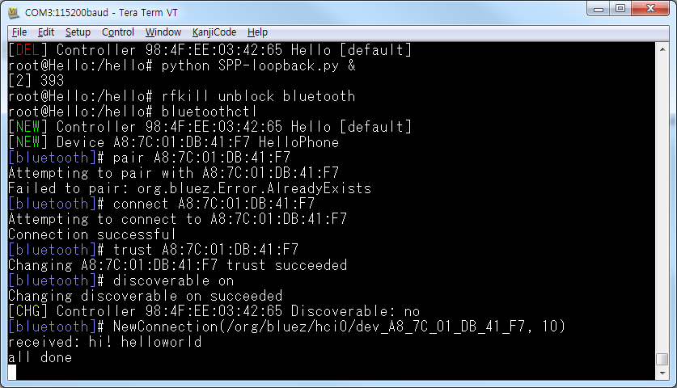
Bluetooth SPP Test
3) SPP Test Program Run (Smart Phone), Download and install : Google Playstore “Bluetooth Spp tools pro”
4) Device connect
5) Byte stream mode -> Text Input
source : http://cafe.naver.com/thingdue

